Slide 1
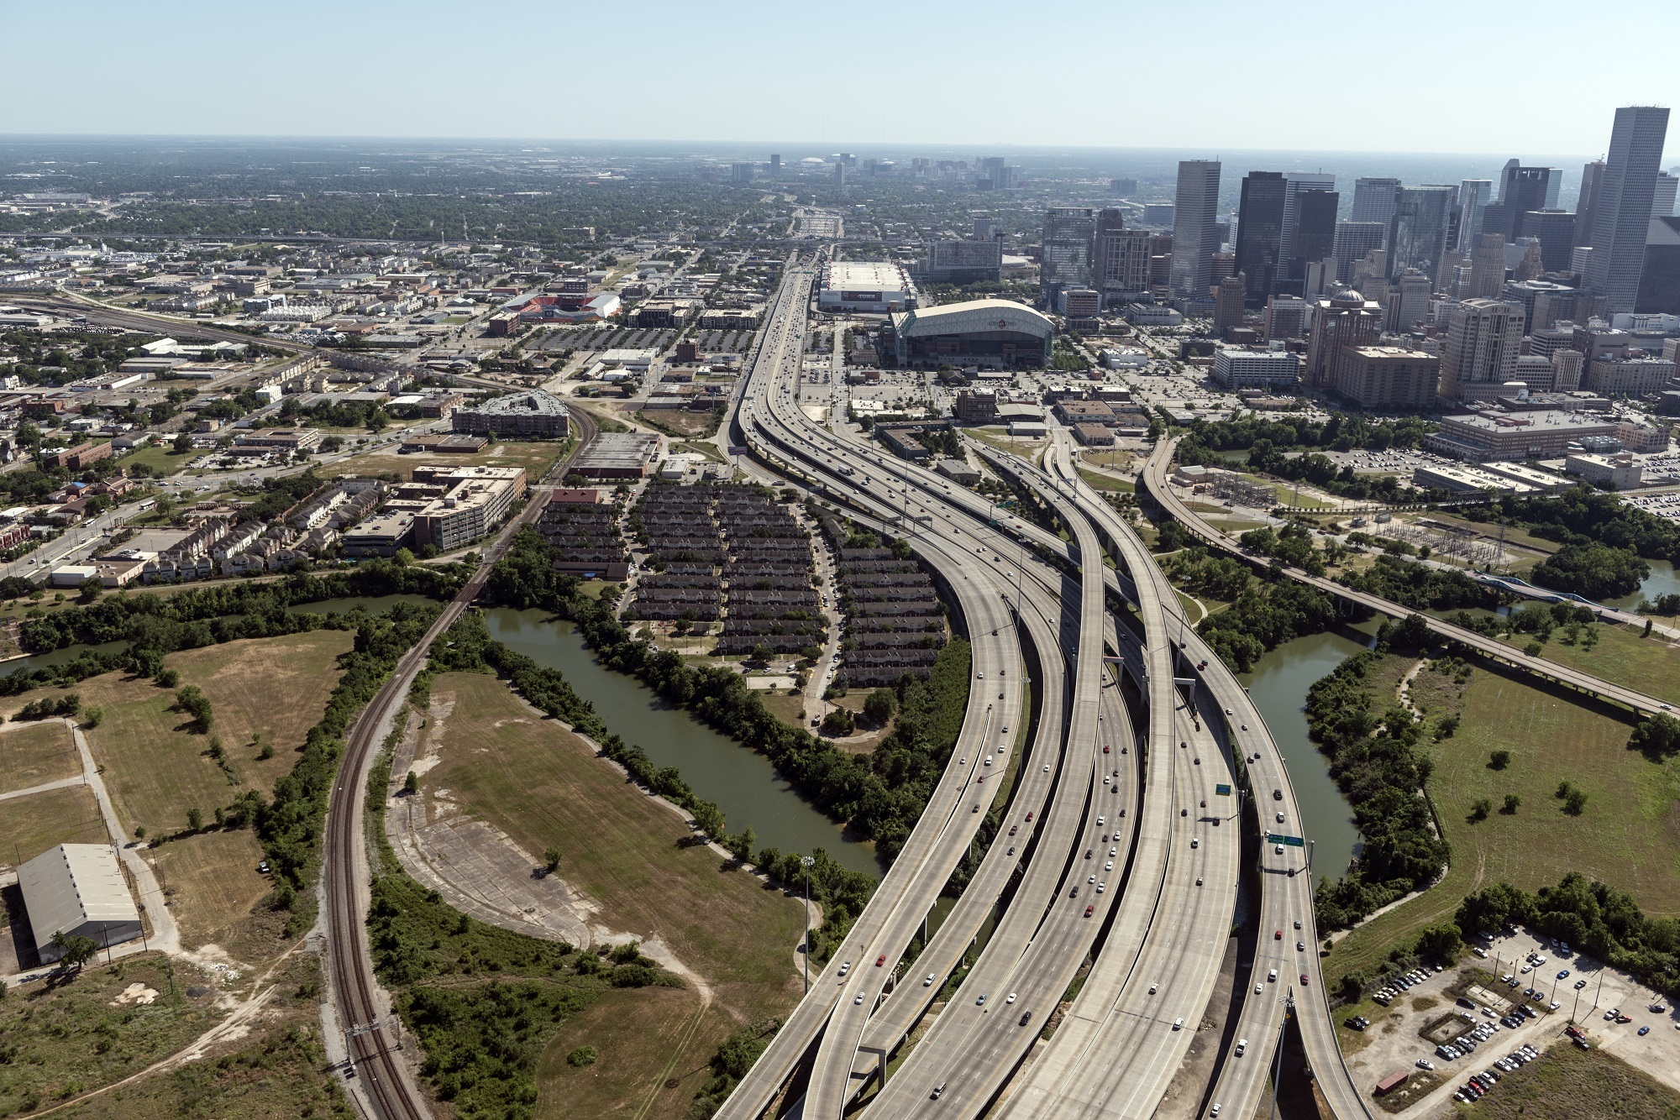
Did you know that in 2013,
Interstate Highways had the
leading number of car crashes
in all Texas’s roadways?

Slide 2
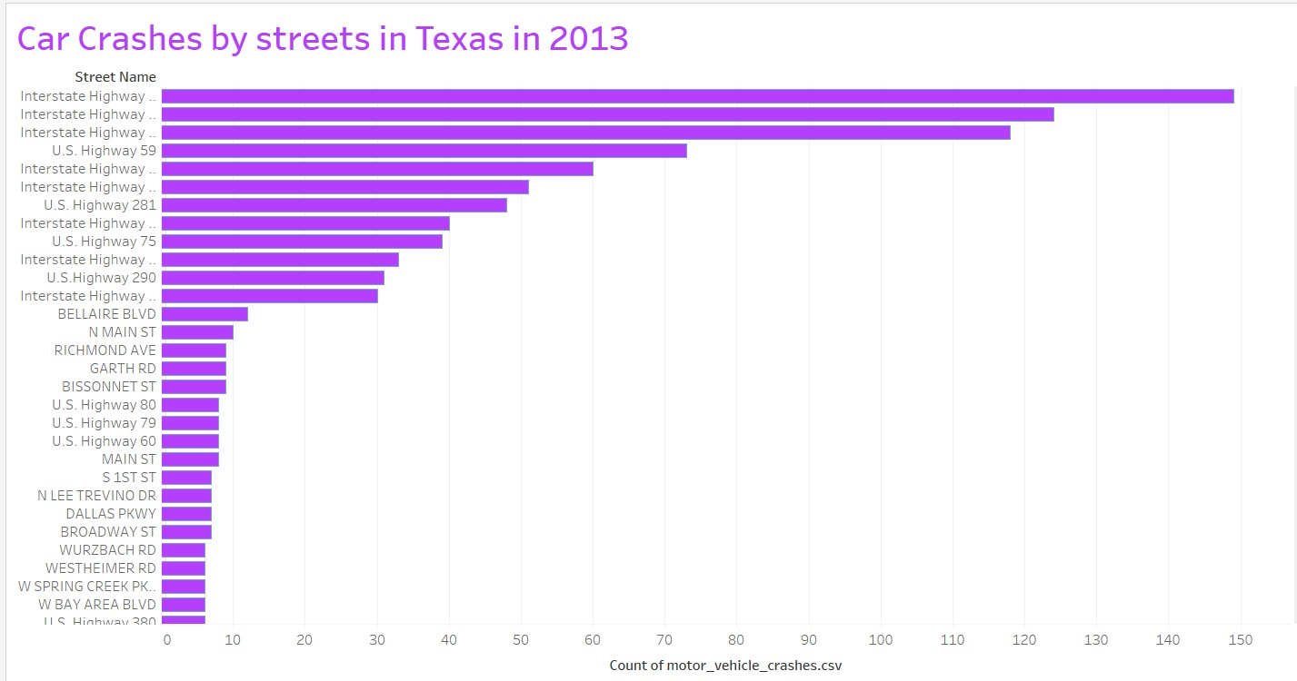
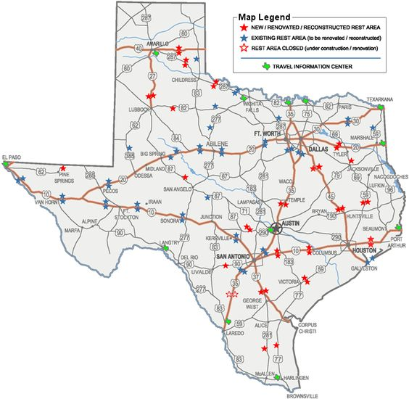

Slide 3
The top 5 roads for car accidents :
Interstate Highway 35
Interstate Highway 10
Interstate Highway 45
U.S. Highway 59
Interstate Highway 20

Slide 4
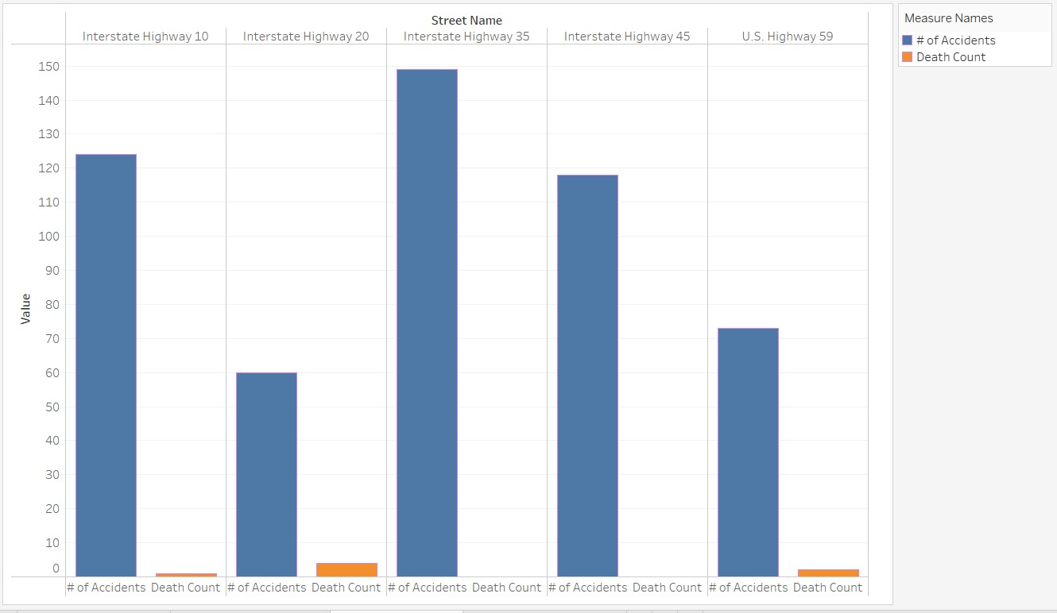
This bar graph represents the total of deaths by car accidents, on those roads

Slide 5
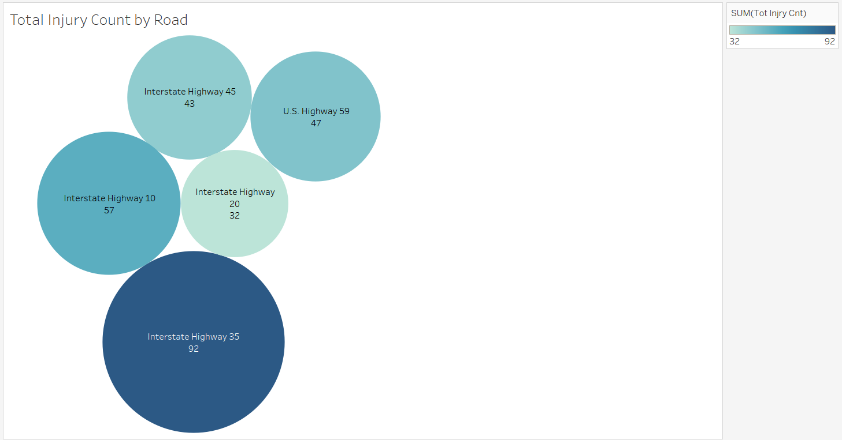
This graph depicts the total of injuries that occurred on those roads

Slide 6
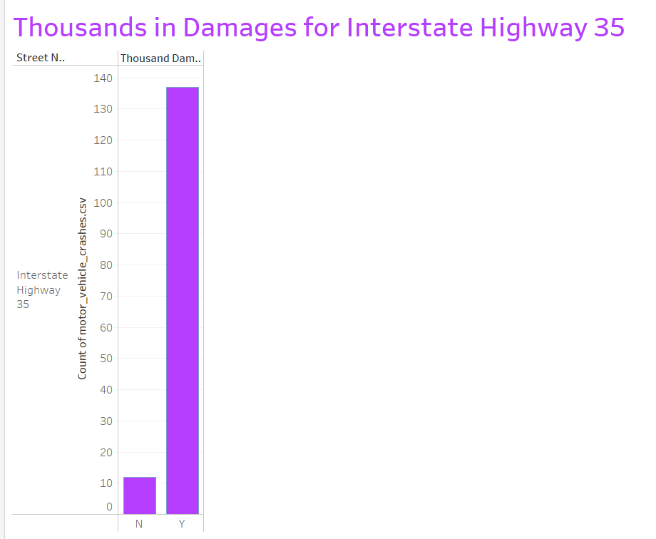
As you can see most of the accidents on
Highway 35 end up with thousands in damages

